Slide 1
Lecture 10 System-Level I/O COMP1411: Introduction to Computer Systems
Dr. Mingsong LYU (呂鳴松)
Department of Computing,
The Hong Kong Polytechnic University
Spring 2023
Acknowledgement: These slides are based on the textbook (Computer Systems: A Programmer’s Perspective) and its slides.
These slides are only intended to use internally. Do not publish it anywhere without permission.

Slide 2
Main message
Understanding the basic concepts of I/O
Understanding file operations in programming

Slide 3
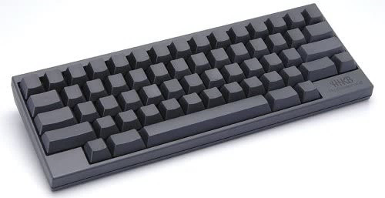
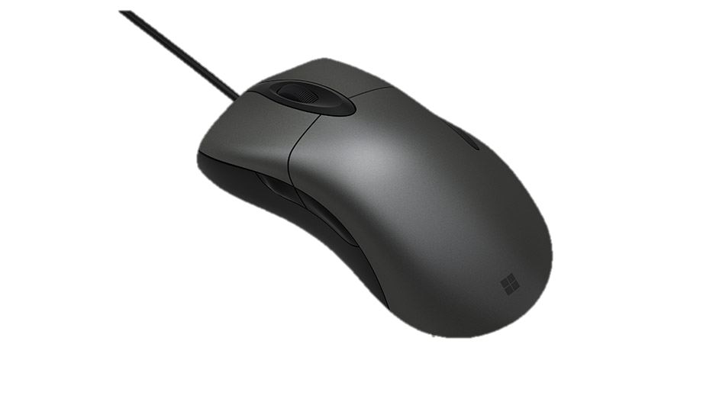

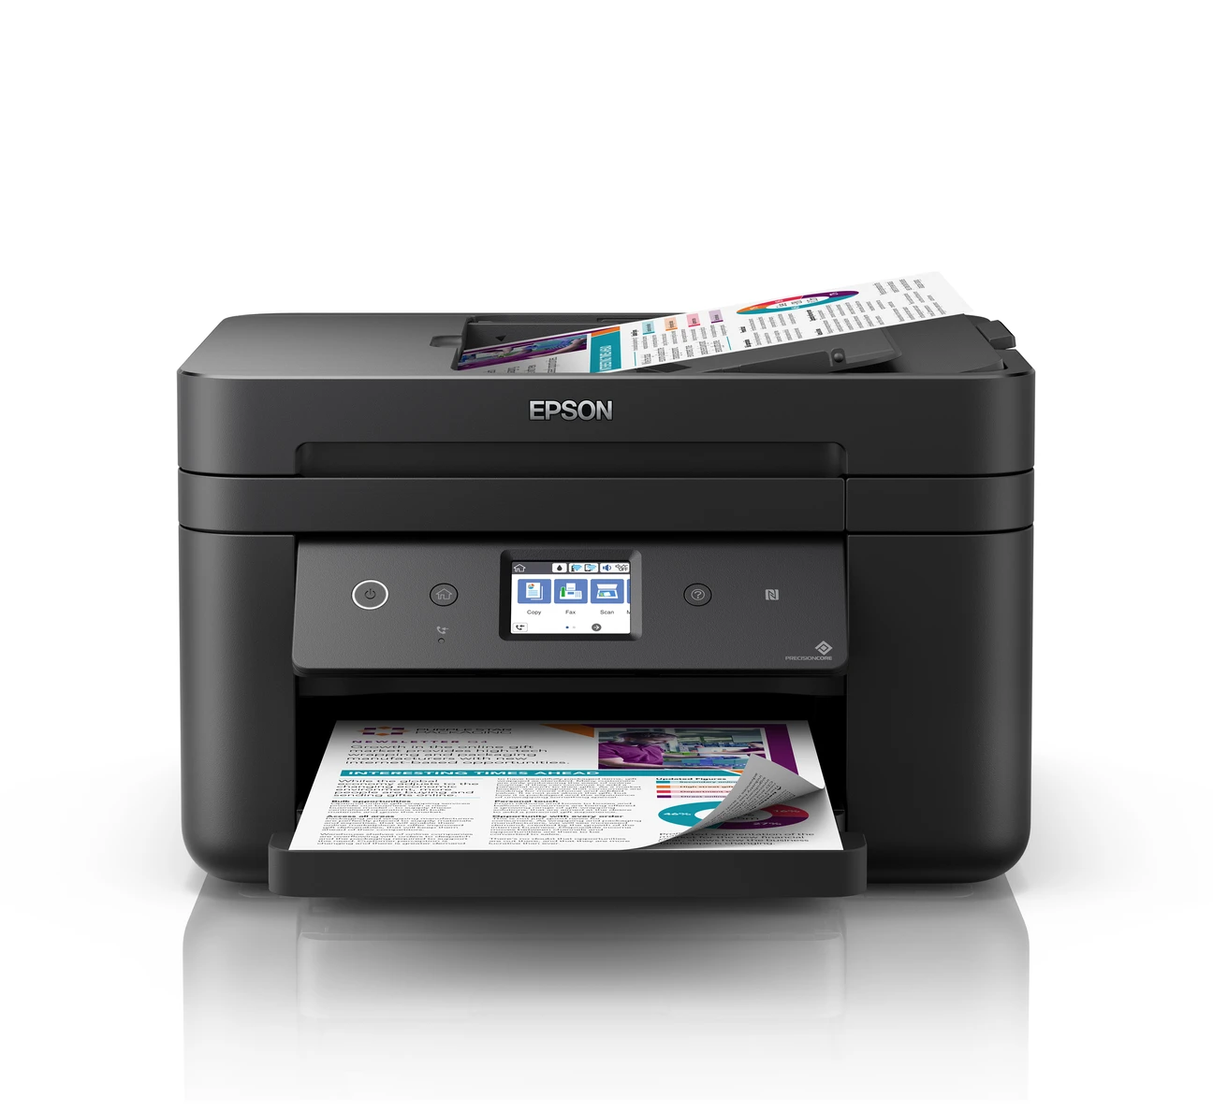

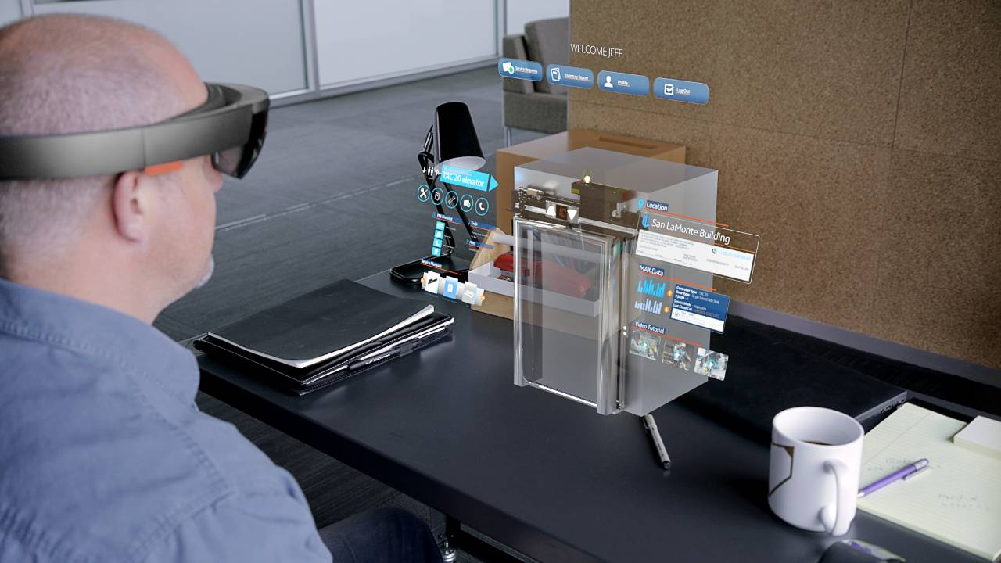
An overview of I/O devices
Computer hardware
The narrow view: CPU + memory
The general view: CPU + memory + I/O
A computer use I/O devices to
Interact with the user, other computers
To do many other work besides computation on the CPU

Slide 4
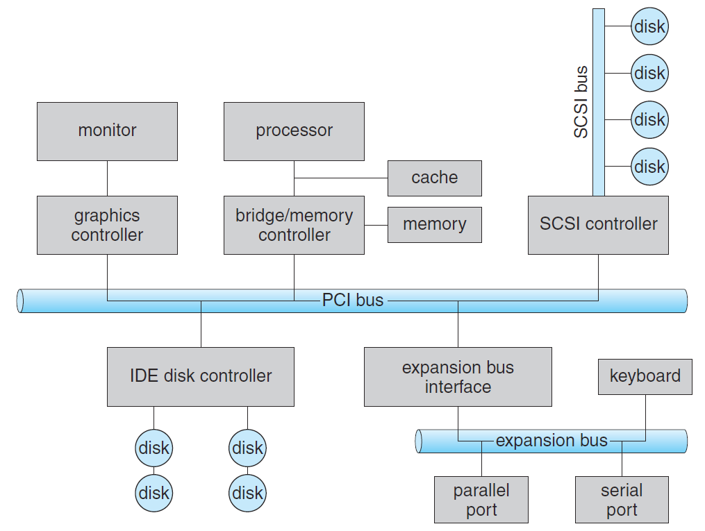
Organization
I/O devices are connected with different levels of buses according to their speed

Slide 5
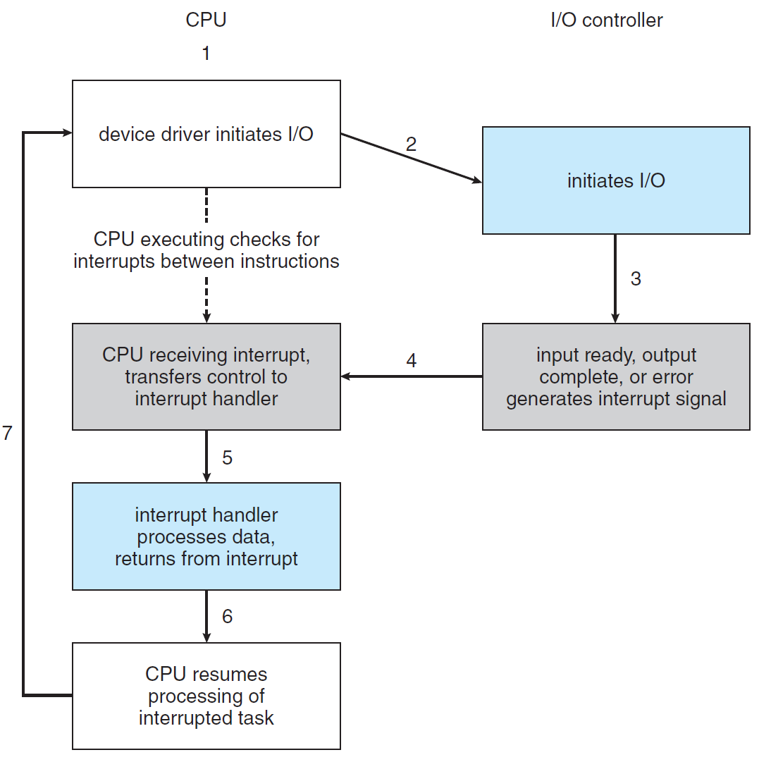
How I/O devices interact with CPU
The main issue: CPU is too fast, I/O devices are too slow
Design principle: should not let CPU wait for I/O devices
Interrupt-based

Slide 6
How I/O devices interact with CPU
The main issue: CPU is too fast, I/O devices are too slow
Design principle: should not let CPU wait for I/O devices
DMA – Direct Memory Access, dedicated hardware helping CPU to move data between I/O devices and main memory

Slide 7
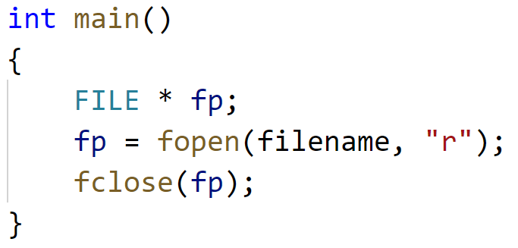
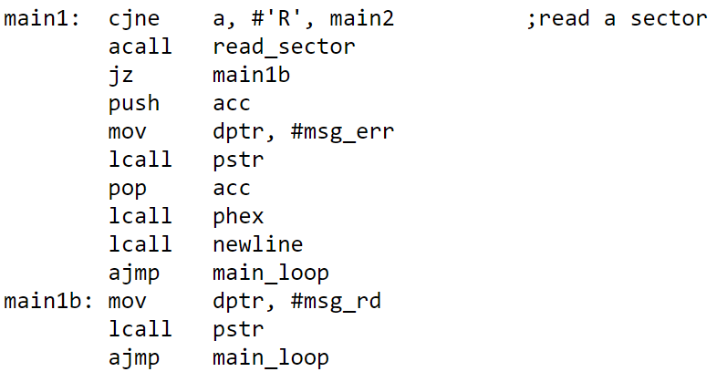
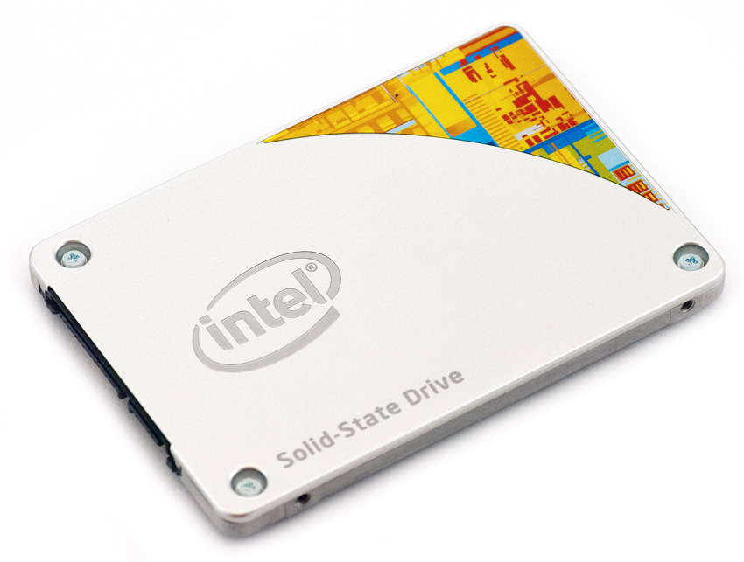
I/O programming
Application program
Standard Library
fopen() fread() fwrite() fgets() fputs() fflush() fseek() fclose()
OS System API
open() read()
Write() lseek()
Stat() close()
Device Drivers

Slide 8

Unix I/O overview
A file (in Unix/Linux) is a sequence of m bytes:
B₀ , B₁ , .... , B_{k} , .... , B_{m-1}
0001101010101010110101001010
0110101010101010111101010011
0101010100111110000101011101
1010010101011001010101100010
0010101011110000100111000100
1110101010101010101010101010
Your view
Computer’s view

Slide 9
Unix I/O overview
Interesting fact: All I/O devices are represented as files
/dev/sda2 (/usr disk partition)
/dev/tty2 (terminal)
Mapping of files to devices allows kernel to export simple interfaces to programmers called Unix I/O
Opening and closing files
open()and close()
Reading and writing a file
read() and write()

Slide 10
Opening files
When you open a file → informs the kernel that you are ready to access that file
Returns an identifying integer file descriptor
fd == -1 indicates that an error occurred
int fd; /* file descriptor */
if ((fd = open("/etc/hosts", O_RDONLY)) < 0) {
perror("open");
exit(1);
}

Slide 11
Closing files
When you closing a file → informs the kernel that you have finished accessing that file
It is important to check the error code
int fd; /* file descriptor */
int retval; /* return value */
if ((retval = close(fd)) < 0) {
perror("close");
exit(1);
}

Slide 12
Reading files
Reading a file → copies bytes from the current file position to memory, and then updates file position
Returns number of bytes read from file fd into buf
Return type ssize_t is signed integer
nbytes < 0 indicates that an error occurred
char buf[512];
int fd; /* file descriptor */
int nbytes; /* number of bytes read */
/* Open file fd ... */
/* Then read up to 512 bytes from file fd */
if ((nbytes = read(fd, buf, sizeof(buf))) < 0) {
perror("read");
exit(1);
}

Slide 13
Writing files
Writing a file → copies bytes from memory to the current file position, and then updates current file position
Returns number of bytes written from buf to file fd
nbytes < 0 indicates that an error occurred
char buf[512];
int fd; /* file descriptor */
int nbytes; /* number of bytes read */
/* Open the file fd ... */
/* Then write up to 512 bytes from buf to file fd */
if ((nbytes = write(fd, buf, sizeof(buf)) < 0) {
perror("write");
exit(1);
}

Slide 14
Going further
Programming practices on file operations in the tutorial

Slide 15
Thank You

